Slide 1
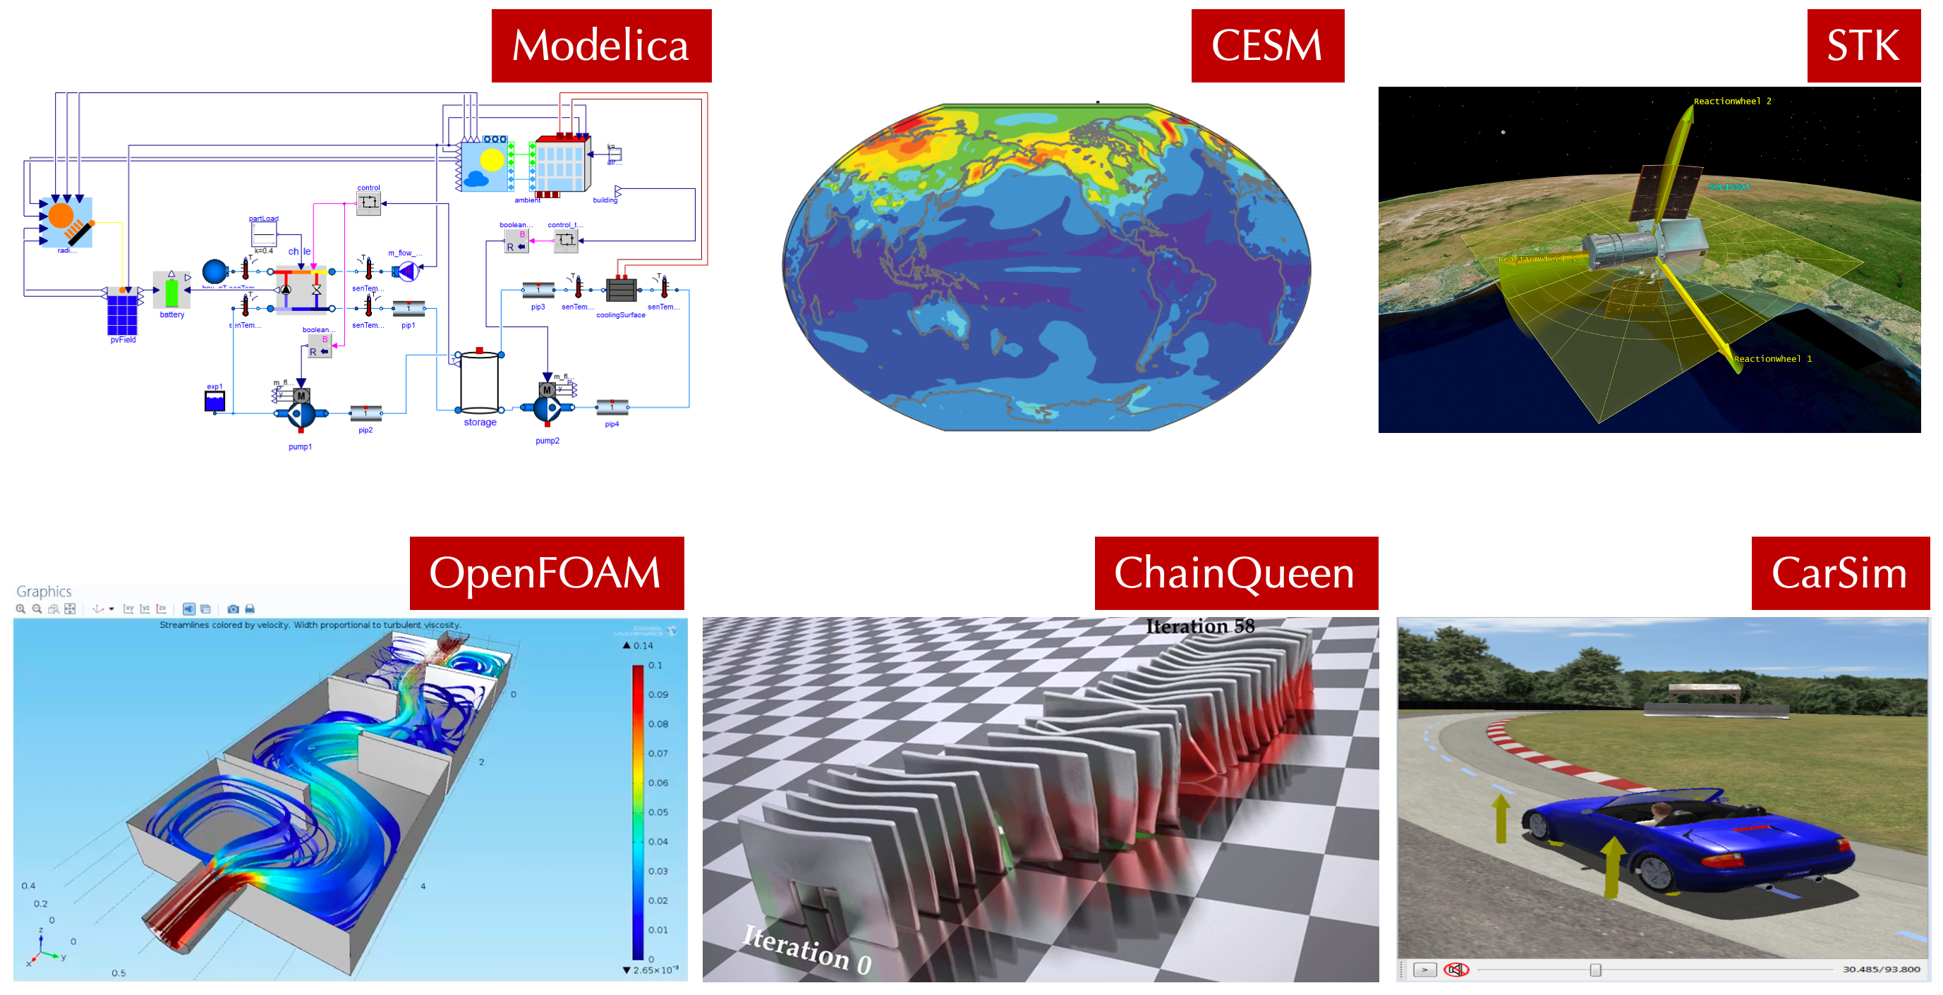

Physics-Informed Digital Twins
Digital twins becoming widely available across many different domains
Defn.: Physics-informed modeling toolkits and simulation environments containing learning modules capable of adapting to operational data to maintain high prediction accuracy over product lifetime
Provides a rapid, scalable, safe, and repeatable alternative to field experiments
May not be entirely transparent
(this part of talk) Critical to design ML methods that can leverage physics-informed simulation data for:
Controller design and online performance optimization
Improving generalization via multi-source data
Data
Adaptation

Slide 2
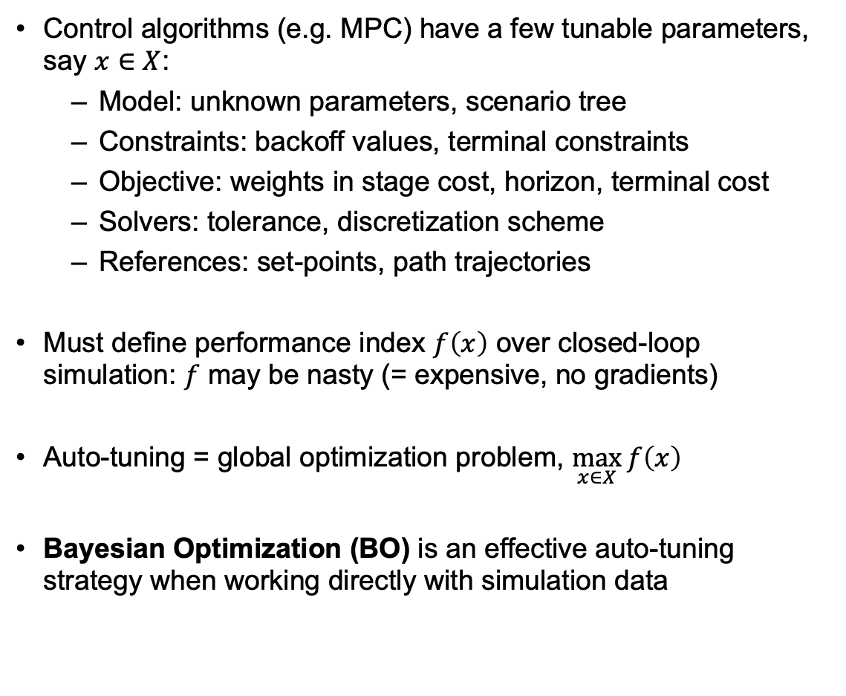
Calibrating (Tuning) Controllers from Simulations
Control algorithms (e.g. MPC) have a few tunable parameters, say $x∈X$:
Model: unknown parameters, scenario tree
Constraints: backoff values, terminal constraints
Objective: weights in stage cost, horizon, terminal cost
Solvers: tolerance, discretization scheme
References: set-points, path trajectories
Must define performance index $f\left(x\right)$ over closed-loop simulation: $f$ may be nasty (= expensive, no gradients)
Auto-tuning = global optimization problem, $\max_{x∈X}{f\left(x\right)}$
Bayesian Optimization (BO) is an effective auto-tuning strategy when working directly with simulation data

Slide 3
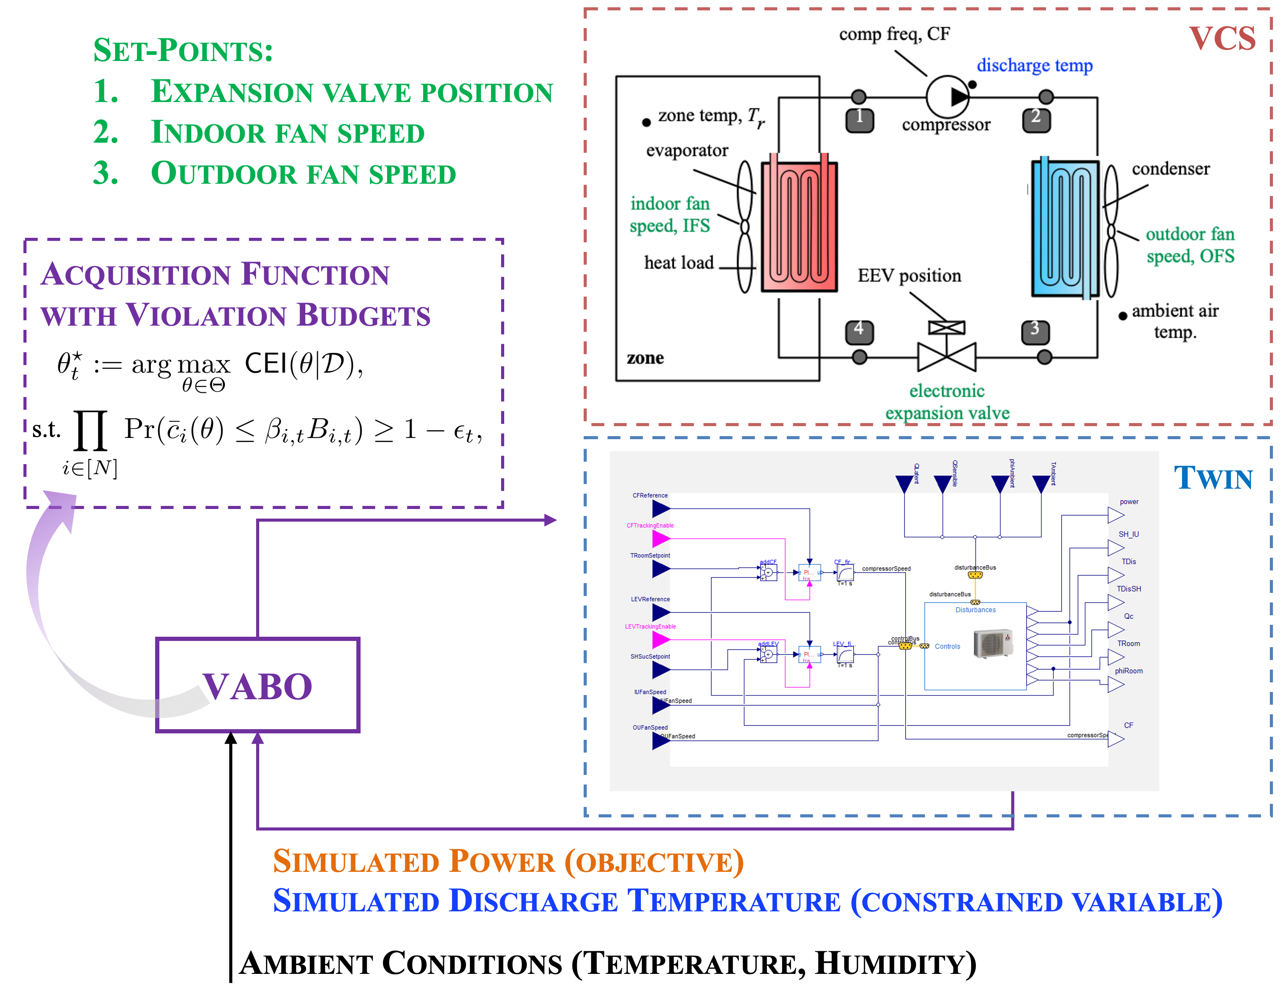
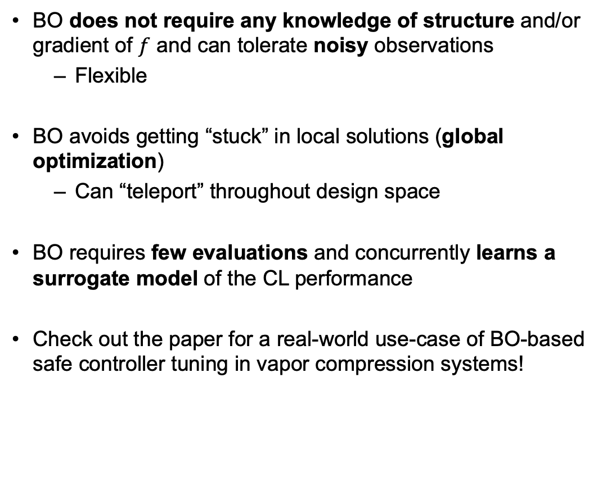
Bayesian Optimization (BO)
BO does not require any knowledge of structure and/or gradient of $f$ and can tolerate noisy observations
Flexible
BO avoids getting “stuck” in local solutions (global optimization)
Can “teleport” throughout design space
BO requires few evaluations and concurrently learns a surrogate model of the CL performance
Check out the paper for a real-world use-case of BO-based safe controller tuning in vapor compression systems!

Slide 4
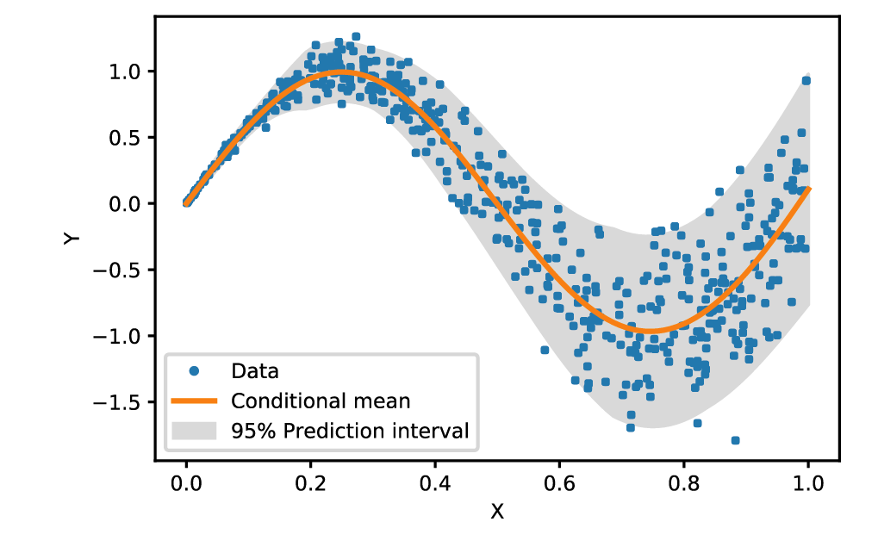
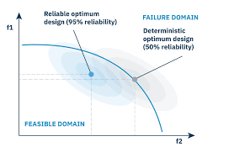
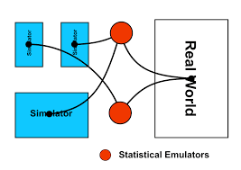
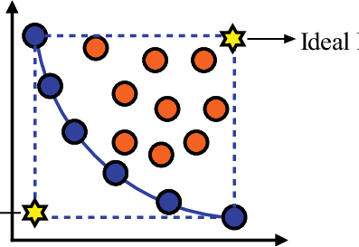
BO is Extremely Flexible & Can Exploit Structure!
Input-dependent noise
Robust optimization
Multi-objective & constraints
[Kersting et al., 2007; Lazaro-Gredilla et al., 2011]
[Paulson et al., 2021; Kudva et al. 2022]
[Makrygiorgos et al., 2022; Lu et al., 2022, Xu et al. 2022]
Notes:
LATEXIT:
f(x) = g(x) + \varepsilon(x)
f(x) = \max_{w \in \mathcal{W}}~g(x, w)
f^{(1)}(x), \ldots, f^{(M)}(x)
f(x) ~~\text{s.t.}~~c(x) \leq 0

Slide 5
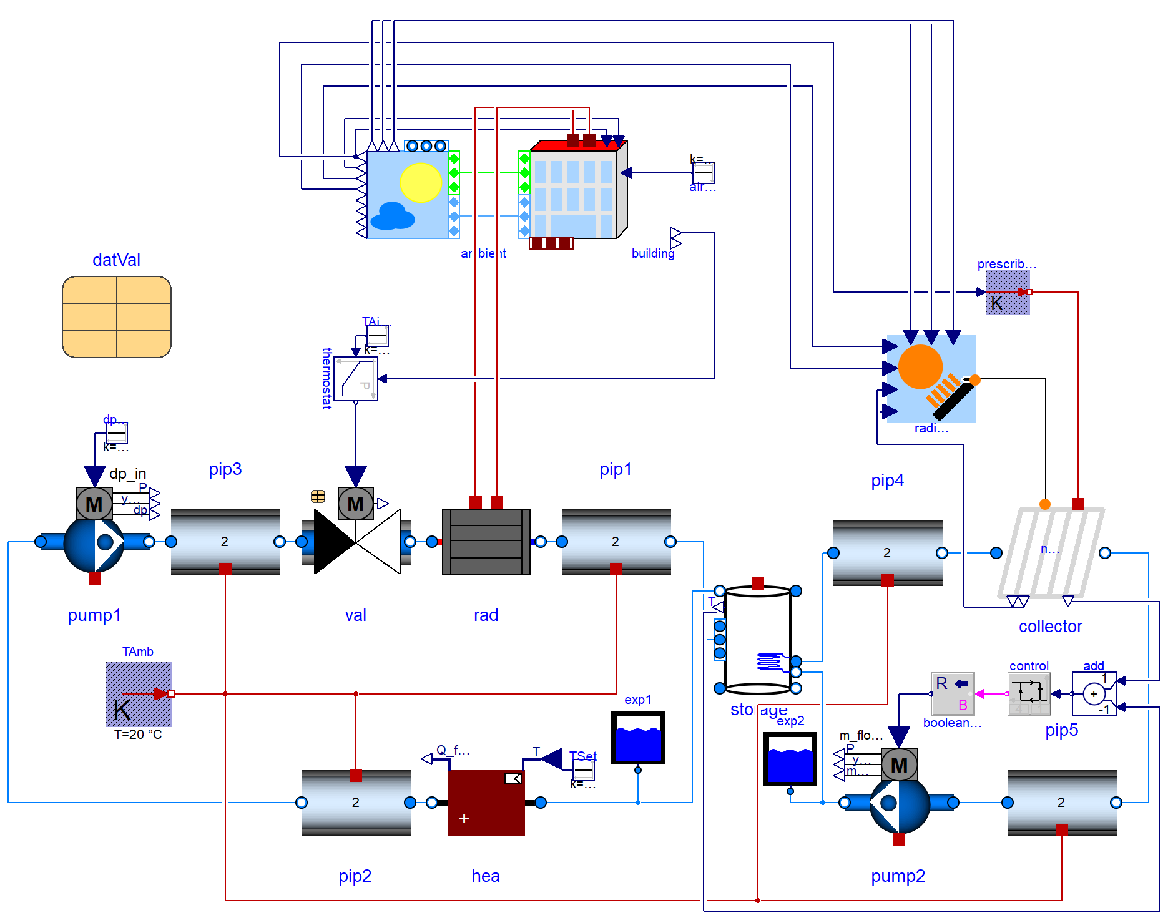


Simulation Environments Enable Generation of Multi-Source Data
PI digital twins comprise parameterized components that can be modified to generate useful data from multiple source systems similar to the target system
This multi-source dataset:
Reduces data requirements from one system by harnessing data from similar systems
Specific ML frameworks are suited to learning from multi-source data:
Meta-learning and transfer-learning
Simulator
Sources
Targets

Slide 6
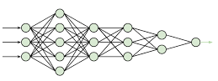
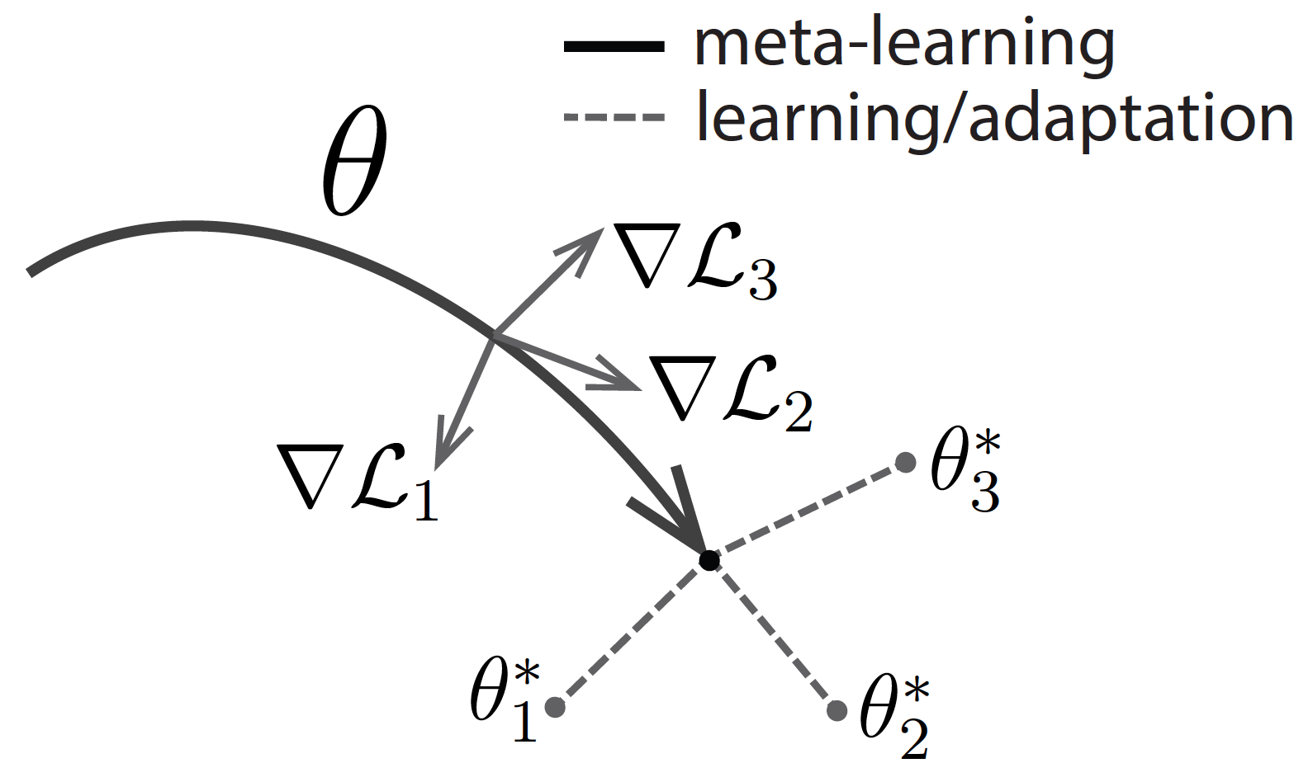
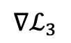
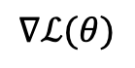
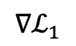
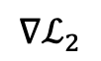
Meta-Learning
Classical meta-learners rely on 2 training loops:
A feature re-use loop for learning features useful over all source data i.e., task-independent
A rapid adaptation loop for network to perform well on single task i.e., task-specific
The adaptation is “baked in” to the training procedure: this will be exploited at inference
Rapid Adaptation
[Finn et al., 2017; Raghu et al., 2019]
gradient step
$$∇ℒ_{1}$$
Source: bair.berkeley.edu
feature re-use
rapid adaptation
$$∇ℒ(θ)$$
data
$$∇ℒ_{2}$$
$$∇ℒ_{3}$$
gradient step
Feature Re-use

Slide 7
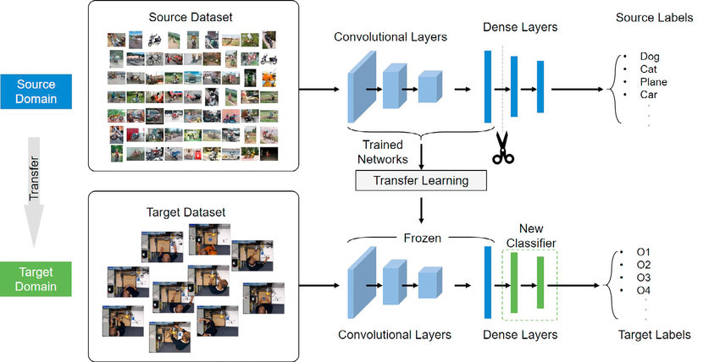
Transfer-Learning
Transfer learning involves two separate single-loop training procedures
1st training phase: learn task-independent representations
2nd training phase: pre-trained network modified and fine-tuned for the target task
Unlike meta-learning:
Adaptation is made problem-specific by 2nd phase, not baked in
2nd-phase training not necessarily few-shot (offline)
Same network may not be used at training v. inference

Slide 8
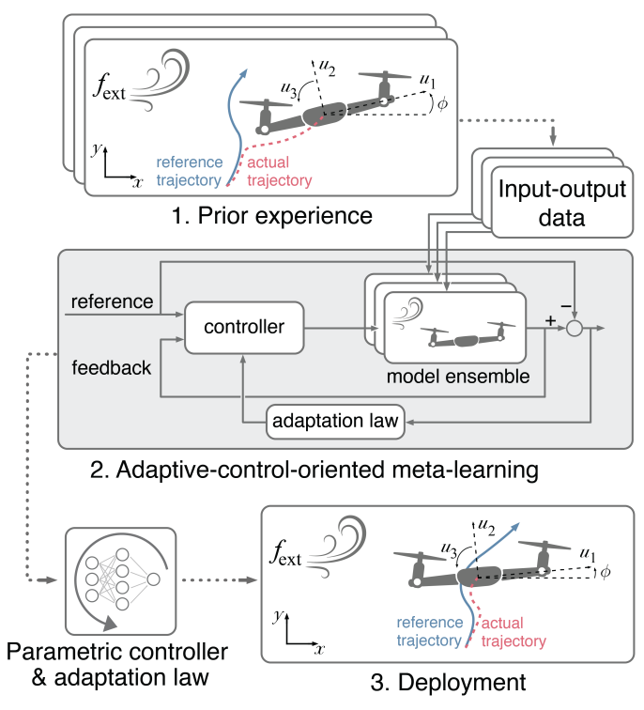
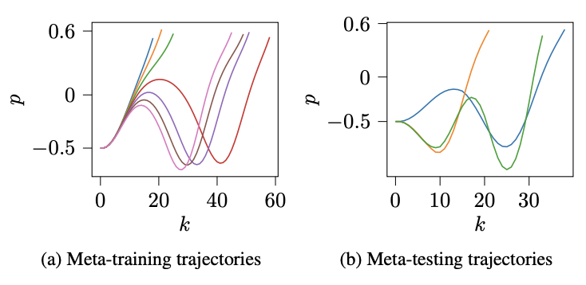
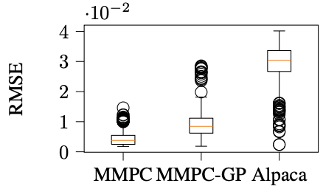
Snapshot of Multi-Source Learning for Control
Meta-learning for model identification:
Meta-GP for MPC
Meta-learned state-space models
Meta-learning for controller and parameter tuning:
Meta-learned BayesOpt
Meta-learned adaptive control
Transfer-learning for modeling and control
Multi-fidelity auto-tuning
[Arcari et al., 2022]
[Chakrabarty et al., 2023]
[Chakrabarty, 2022; Zhan et al., 2022]
[Richards et al., 2021; Richards et al., 2022]
[Chen et al., 2020; Xu et al., 2020]
[Sorourifar et al., 2021]
Notes:
LATEXIT:
f(x) = g(x) + \varepsilon(x)
f(x) = \max_{w \in \mathcal{W}}~g(x, w)
f^{(1)}(x), \ldots, f^{(M)}(x)
f(x) ~~\text{s.t.}~~c(x) \leq 0

Slide 9
Opportunities for PIML4C
Modeling of human(-in-the-control-loop) behaviors
Automated adaptation via simulation (closing sim2real gap)
Integration of multimodal signals (speech, image/video) into control loops
Interpretable and verifiable control policies via physics injection during learning e.g. explicit MPC
Providing safety and performance guarantees – new theoretical tools
Notes:
LATEXIT:
f(x) = g(x) + \varepsilon(x)
f(x) = \max_{w \in \mathcal{W}}~g(x, w)
f^{(1)}(x), \ldots, f^{(M)}(x)
f(x) ~~\text{s.t.}~~c(x) \leq 0

Slide 10
Challenges for PIML4C
Quantification of ‘minimal’ = ‘useful’ and ‘useful’ data requirements
Quantification of uncertainty and modeling errors
Quantification of similarity in multi-source learning
Formal guarantees of safety/stability for closed loop PIML based controllers
Scaling up of verification methods
Notes:
LATEXIT:
f(x) = g(x) + \varepsilon(x)
f(x) = \max_{w \in \mathcal{W}}~g(x, w)
f^{(1)}(x), \ldots, f^{(M)}(x)
f(x) ~~\text{s.t.}~~c(x) \leq 0

Slide 11
Summary & Conclusions
Classically, ML methods do not integrate known physical constraints
PIML methods have emerged to systematically combine data-driven ML with physics-based modeling
PIML methods offer new and exciting opportunities for human-in-the-loop, multi-scale and multi-physics systems
Open challenges remain: an exciting time to solve problems in PIML!
Notes:
LATEXIT:
f(x) = g(x) + \varepsilon(x)
f(x) = \max_{w \in \mathcal{W}}~g(x, w)
f^{(1)}(x), \ldots, f^{(M)}(x)
f(x) ~~\text{s.t.}~~c(x) \leq 0

